Slide 1

Emirati Career Growth and Development - Briefing

Slide 2
By the end of this briefing, you will be able to:
Develop Emirati associates through planned development in a high performance culture
Have career and development conversations that can drive engagement across the Emirati community in our division
Know how you can support our Emirati associates in terms of development

Slide 3
Reality check – We need to up our game and create a competitive advantage to attract , develop, retain and engage our national workforce
Localisation is an integral part of business strategy and growth in relevant markets
Opportunity to improve skills seems to be a key driver for the outcome metric of Loyalty
Favorability scores in the Dimension of Our Growth and Our Dialogue has declined
“My immediate supervisor takes an interest in my growth and development” is in the bottom 10 most unfavourable statements in our Growing together survey 2022

Slide 4
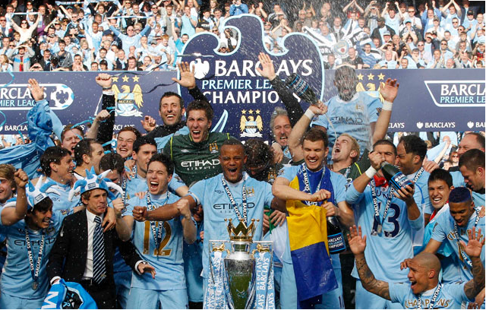

Best practices for People management- What do managers of these teams practice that makes them win?
Spend a few minutes thinking about the practices that you think managers of these teams demonstrate that enable them to win?

Slide 5
Key areas that managers need to focus on to drive performance
Managing the business
Engaging people
Driving Performance
Identify talent
Develop myself and others
Set objectives
Measure Performance
Give & receive feedback
Coach
Notes:
When we talk about ‘Managerial Effectiveness’ we are talking about three key areas that managers need to focus on to drive performance. These three key areas are:
Managing the Business
Engaging Employees
Driving Performance
I’m not going to focus on how you manage the business as you know best. However the key here is how do we engage our people and help drive performance

Slide 6
Manager behaviors which impact engagement
Clear, open & regular communication
Frequent feedback on role & progress
Source- Gallup
Notes:
Gallup went more in-depth and had respondents identify which manager behaviors made them feel engaged and more likely to stay.
Clear, open and regular communication
Simply put, the more communication an employee has with their manager, the more engaged they feel. This can be in almost any form — email, phone calls, meetings, etc. The study found that regular meetings can result in employees being three times more engaged. And work talk is just the half of it. Employees are truly engaged when they feel their managers care about their lives outside of the office. When workers can form a personal connection with their managers, they’re much more likely to stick around.
2. Frequent feedback on role & progress
Those surveyed said frequent feedback from their managers made them more engaged. When employees aren’t clear on their goals, duties or how they’re performing, they can feel disconnected from the organization. When managers consistently discuss responsibilities and progress, employees are much more focused and engaged.
You might say this is applicable for everyone- Yes that’s true, but then let’s go back to our localisation strategy and the need to engage and retain our National workforce and create that competitive advantage for them

Slide 7

How to create planned development for our Emirati associates

Slide 8
30
58
9
25
53
6
46
2
17
57
49
10
54
1
33
22
38
41
37
50
45
18
13
29
21
34
26
5
14
42
4
52
55
11
32
12
3
35
56
48
16
27
44
40
39
19
20
60
15
43
51
31
24
28
8
47
36
59
7
23
Notes:
.

Slide 9
30
58
9
25
53
6
46
2
17
57
49
10
54
1
33
22
38
41
37
50
45
18
13
29
21
34
26
5
14
42
4
52
55
11
32
12
3
35
56
48
16
27
44
40
39
19
20
60
15
43
51
31
24
28
8
47
36
59
7
23

Slide 10
What is an Individual Development Plan
Individual Development Plan (IDP) is a tool to organize and target development needs.
Its primary focus is to help strengthen the current job performance and achieve short to long term career goals through a structured, well-rounded approach.
Benefits are tremendous
Lays out the employee career ambition and objectives and the path to take towards achieving them.
Aligns employee career aspirations with business needs and strategy
Ensures that the employee is continuously provided with the opportunity to learn and stretch within a continuously changing business environment
Sets up clear expectations between the employee and the manager
Increases Employee engagement and retention.
Notes:
You may think the IDP as just a plan, however it requires a lot of thinking and the benefits are tremendous

Slide 11
How can you support them?
Assess where the learning needs to happen (current or future role)
Understand the current Strengths and Areas for Development through:
Feedback received from different stakeholders (manager, peers, customers etc.)
Technical (where present) & Leadership Competencies
Performance Evaluation/ 360 feedback/ additional assessments including external
Job specific skills
Understand How they learn Best
By Doing
By Observing others
By Understanding the theory
Match learning needs to learning interventions
Notes:
Can you identify how the Emirati associate in your areas learn?

Slide 12
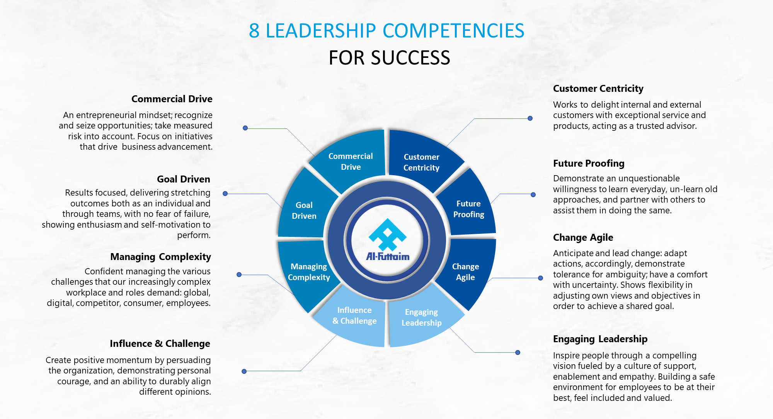
Understand the current Strengths and Areas for Development
Notes:
Once you have identified where the learning needs to happen, you then look at their areas of strength and development .
As we said earlier part of building their development plan is understanding their current Strengths and Areas for Development and one of the ways is knowing where they stand in the leadership competency
I am sure you are all aware that THE updated leadership competencies is rolled out. We have already expanded each leadership competency into 3 proficiency level, level 1,2 & 3. And if you wish to grow in the leadership ladder, these competencies will give you insights on what you need to demonstrate. If you want to learn more about the competencies based on your band you will now know what is excepted from you.

Slide 13
Job specific skills
Sales | Marketing | Finance
CRM Sales Force Inventory management | Copywriting Digital Media Content Creation | CPA CMA IBM Cognos Controller
HR | IT | Legal
Job Evaluation CBI Labor law | ERP Systems Java Script CSS | Employment Law Legal Writing Appeals

Slide 14
Own Feedback & Others Feedback- conversations you can have when discussing development areas
 | WHERE ARE YOU NOW? | WHERE ARE YOU GOING?
 | Abilities (How I see myself) •Where have you been most successful? •What skills have contributed to that success? •In what areas are you most likely to offer your expertise to others? •In what areas do you turn to others for assistance? •What are your strengths? What is the capability, that if you got better at it, will have a significant positive impact on your career? | Goals & Values (What matters to me) •What do you want to do that you are not doing now? •What gives you the greatest sense of satisfaction and reward? •Where would you like to see yourself, 2 years down the line? What roles/ situations would enable you to leverage your strengths even further? •What additional skills would be helpful for you?
 | Perceptions (How others see me) •Where and for what purpose do others generally reach out to you for support? •What do others say concerning your strengths and development needs? •What is your reputation with different groups and at different levels in the organization? | Success Factors (What others expect in me) •What are the criteria for success in your current/ future position? •What examples of success have you seen in others with similar roles? •What does your manager or other senior leaders value most about you? What do your current stakeholders want to see more of, from you?
YOUR VIEWS
OTHERS VIEWS
Notes:
We also spoke about getting feedback- from you and others- conversations may differ depending on the level of performance . If someone is exceeding or distinguished, then speaking about a future role would make sense, Someone in fully performing may need to demonstrate potential for a future role and the discussion should reflect this aspect

Slide 15
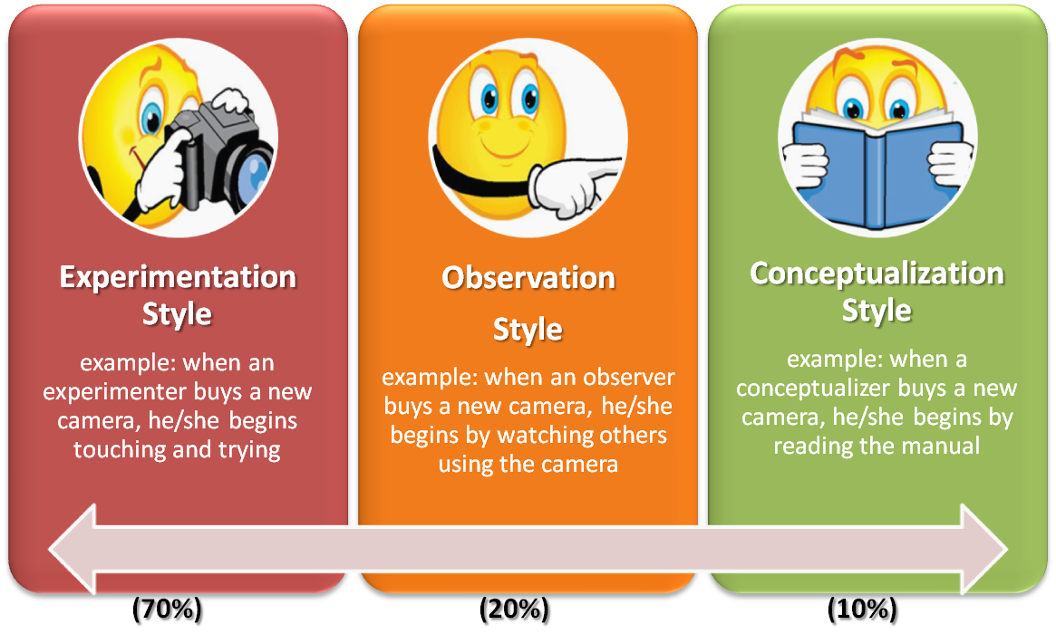
Learning styles
Notes:
The 70-20-10 rule reveals that individuals tend to learn 70% of their knowledge from challenging experiences and assignments, 20% from developmental relationships, and 10% from coursework and training.

Slide 16
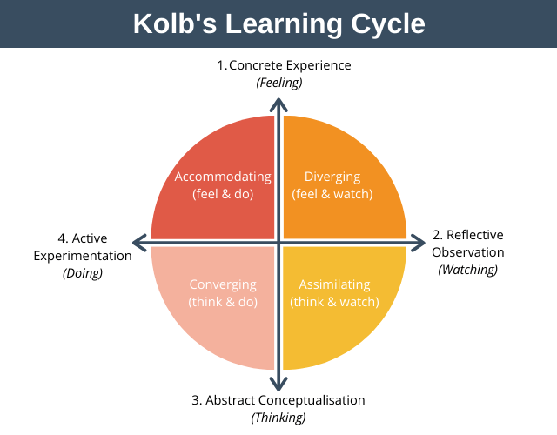
Learning styles
How you Learn BEST
The learner can enter the cycle at any point however, it is important to close the learning cycle by ensuring the learner experiences all four quadrants.
As adults we all have a preferred way of learning, some learn best by doing, others by observing others do, and others prefer to understand the theory behind.
Notes:
After reading the text- so what does this mean for you- next slide

Slide 17
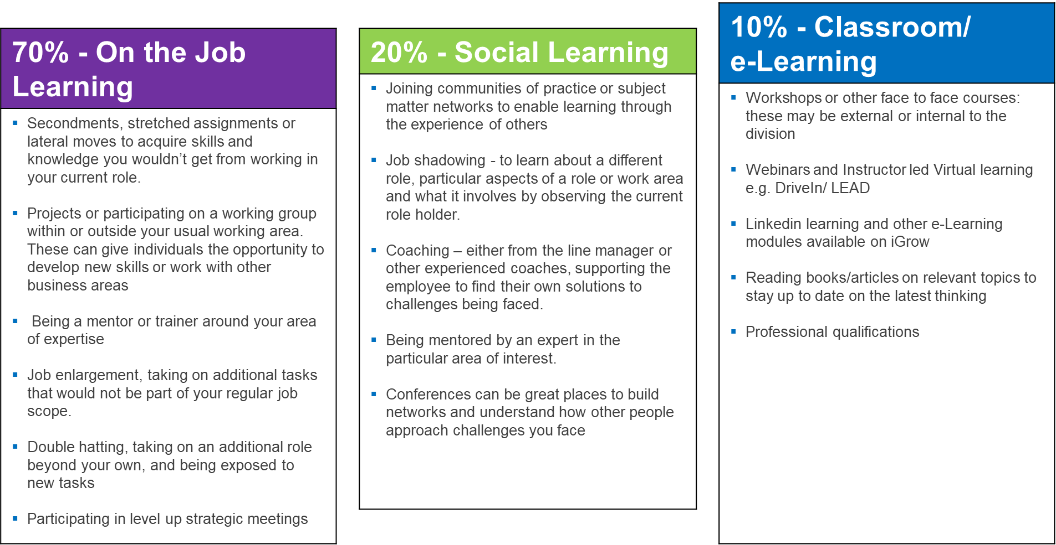
Learning approach
The 70/20/10 learning approach is a widely used learning and development model which captures three types of learning: experiential, social and formal.
Notes:
This means that your support for the employee should replicate the 70-20-10 principle. The 70-20-10 rule reveals that individuals tend to learn 70% of their knowledge from challenging experiences and assignments, 20% from developmental relationships, and 10% from coursework and training.

Slide 18
70/20/10 activity

Slide 19
Learning Approach
You have below 4 development goals. Put the development goal number between brackets to the relevant learning approach
Development Goals:
Get better at presenting in public
Improve my ability to work in teams
Develop my analytical skills
Work on my ability to work in ambiguity & change
70% - On the Job Training |  | 20% - Social Learning |  | 10% - Classroom/e-Learning
Being part of/leading a transformation project. ( ) Join a cross functional Project that will work on building a reporting dashboard. ( ) Request for the opportunity to present during your team /department meetings. ( ) Look for the opportunity to be part of a cross functional project. ( ) |  | Shadow a colleague who is strong in presenting, through the whole process of structuring, developing and delivering. ( ) Get mentored by a business leader on ways to work in an unstructured environment. ( ) Attend a peer learning circle and participate in the working groups. ( ) Job shadow the reporting & analyst specialist in your teams |  | Attend the Presentation skills training that is on the Drive-in calendar. ( ) Enroll in the reporting & analysis certificate. ( ) Read Kotter’s book on leading change. ( ) Listen to Tedtalks about the importance of teamwork and team dynamics. ( )
Remember the development actions may differ due to job levels and current or future role
Notes:
70-20-10 is a model of learning, but needs to be in chronological order where 10% structured learning should be an ideal development before they actually apply it, example- Presentation skills,
Once the goal is set- then feedback and coaching should be part of the learning cycle.

Slide 20
Individual development goal examples
Development Objective | Skills/ knowledge & behaviour | Action steps/learning activity | Organizational/ manager support | Success measures | Target Date Completion
Drive a culture of innovation in my team to enhance our customer centric approach | Innovation & Engagement | Set up monthly innovation sessions to discuss new ideas with the team you lead. Read about tools and techniques to facilitate design thinking sessions Solicit input from multiple sources, including your juniors, before making a decision. | Provide coaching on how to drive team innovation. | Engagement Survey (culture question) | July 2022

Slide 21
Keep in mind that development goals
Should be built of factual data and observations, based on the best opportunities to bring about growth.
Should be relevant to their individual performance and career aspirations.
Should be SMART – Specific, Measurable, Achievable, Realistic and Time bound.
Should be addressed as development and never a weakness.
Should apply the 70/20/10 rule, 70% of the development plan should be focused on on-the-job experiences, 20% on social such as mentoring & coaching, and 10% of formal classroom/computer-based training/e-learning.
Should gain your support to help you strengthen the organization’s commitment to your development goals and also secure mutual accountability for achieving your development target.
Should concentrate on ways to leverage strengths as well as improve areas where you need development.
Notes:
SMART- accountability. Part of the plan is to add accountability.- Employee needs to take accountability of the pln and managers need to support
Ex- Coaching- If you tell the associate to get a coach then the goal is SMART only if they add an action- meet twice with my coach to address the following topics

Slide 22
Your support as a manager
Use coaching and feedback as a tool to create different perspectives in order to progress & move forward.
Encourage them to ask support from various sources for their development goals, such as :
Matrix manager
Mentor /A coach from within or outside the Division
Trusted peers
Subject matter expert/Senior Professionals in the area you want to develop skills or a career
Stakeholders who can provide useful feedback on your strengths and areas for development
Have a balance of short-term goals with a longer-term ambition
Make sure they understand all points discussed and also ensure you are aligned with their IDP
Ask them to update their IDP in IGrow and use CPM to record their activities and achievements
Have regular check-ins to track and discuss progress on their development goals
Success of their development leads to the success of their career growth
Notes:
Promotion - example

Slide 23
Continuous conversations- Having regular check-ins

Slide 24
Performance feedback and coaching
When do I provide feedback and coach?
Performance appraisal
Setting business/learning goals
Delegation
Career development
General on-the-job training
Notes:
Providing feedback and coaching enables your staff to:
work towards and reach their goals
develop their skills
learn how to better perform on the job with your coaching and support
There are different types of situations where you can use feedback and coaching:
1. During the performance appraisal reviews
2. As tools which will support objective setting and delegation
When discussing the progress of the employee on achieving their objectives, giving feedback is necessary in order to share your observations and the impact that their actions had. It is also a way to communicate whether their action/ behaviour is effective and achieves the necessary outcomes or is ineffective and needs to change.
3. For career development
Developing the employees is part of a manager’s role and also is a driver of engagement.
4. For general on the job training
You use feedback when you want to ensure that the employee will continue with an effective behaviour or will change an ineffective behaviour.

Slide 25
Performance feedback and coaching- Activity
Put the following actions in the correct order of the performance feedback and coaching cycle
ASSESS
SET GOALS
COACH
GIVE FEEDBACK

Slide 26
Set Goals
Assess
Coach
Give Feedback
Notes:
This is the typical approach that managers use when managing their employees’ on tasks given or objectives set to enable them to achieve expected performance standards.
Effective performance management will rely on both formal and informal activities that continue to support the development of a performance driven culture within Al-futtaim
Part of your management role and responsibilities is for you to provide a “high challenge” and “high support” environment in order to ensure we meet our overall targets and strategic objectives.
Both feedback and coaching are critical for effective performance management and it is expected that ongoing formal and informal feedback take place consistently during the year.
TRANSITION: Let’s take a look at what effective feedback looks like first...

Slide 27


feedback
coaching
27
past behaviour
future
behaviour
evaluate & correct
develop
tell
ask & help
find own way
Notes:
People are often confused about the definition of coaching and how it differs from feedback.
While there may be some overlap, these are two very distinct methods of interaction.
There is a difference in FOCUS, PURPOSE, and MEANS.
The FOCUS of feedback is on past behaviour. The FOCUS of coaching is on future behaviour.
The PURPOSE of feedback is to evaluate and correct. The PURPOSE of coaching is to develop.
The MEANS of feedback is by telling. The MEANS of coaching is by asking and helping a person to find their own way.
Both tools are important, and every leader needs to have both in their toolkit.
It is also important to note that sometimes we use the term ‘coaching’ in a negative sense, i.e if someone is underperforming, we say “he needs coaching”. However, coaching is a very POSITIVE TOOL that can be used for people’s growth, development, and problem-solving in almost all situations. What we want to say very clearly here is: we believe that coaching should be the PRINCIPLE TOOL of the manager and should be used much more frequently than corrective feedback.

Slide 28
Next steps

Slide 29
All UAE nationals across Automotive division have been asked to register for the IDP sessions running through May and June with 2 sessions a day.
Objective- Introduce the concept of planned development and provide them with the tools and resources on how to build a robust Individual Development Plan to fuel their career growth within the Al- Futtaim Automotive Division.
Outcome- 100% of Emirati associates have IDP recorded in iGrow
Quarterly Leaderboards to ensure IDP s are implemented
No of UAE Nationals within Automotive: 373

Slide 30
Career Growth and Development template

Slide 31
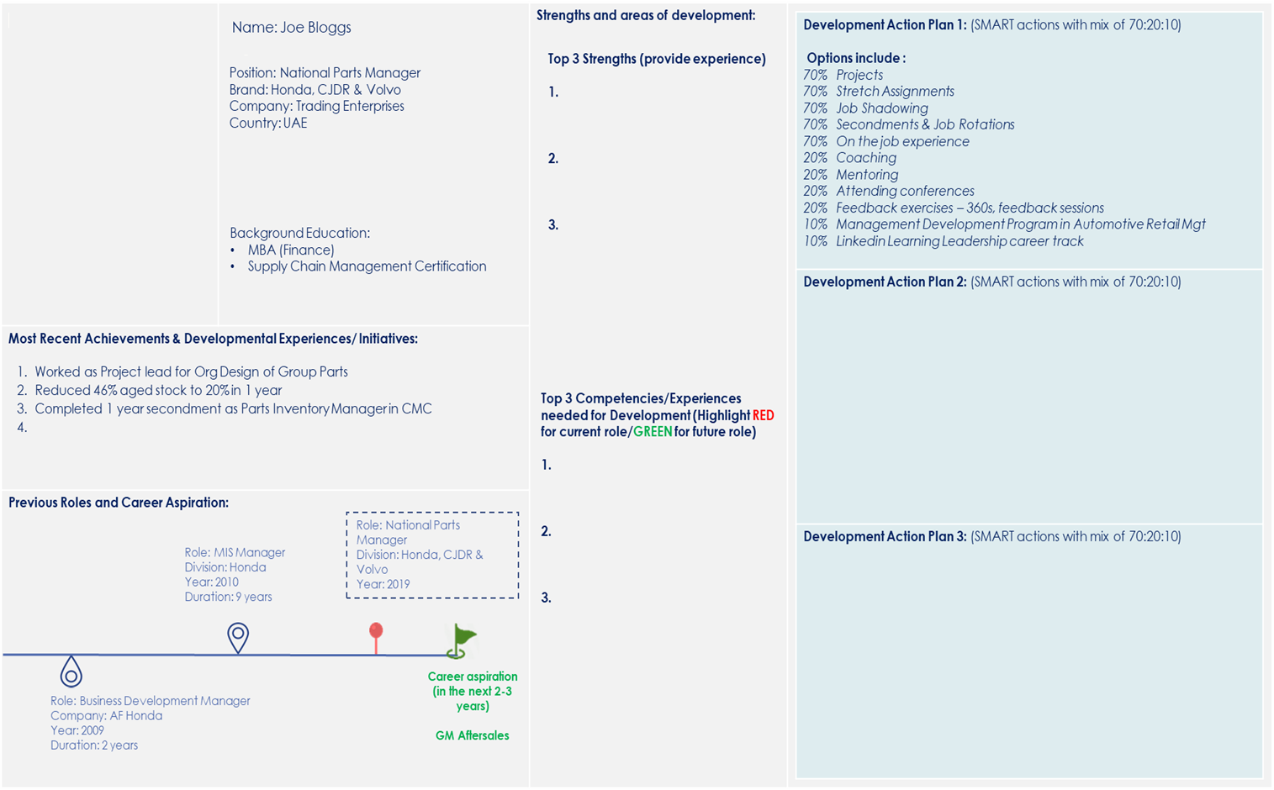
Career Growth & Development Template Example
IDPs available for all associates
2 types of IDP
1. Development in current role
Orange pin represents current role
2. Development towards future role
Green flag represents future role
70:20:10 development must be developed by the associate to ensure accountability of their own development – HRBPs and management support to enable opportunities for development through launched mechanisms

Slide 32
Talent Mgmt. Plan on a Page [POAP]
Completed
On Track
Slightly Delay/Issue
Significant Delay/Issue
On Hold
Plan on a Page [Milestones view]
Activity | 2023
 | Jan | Feb | Mar | Apr | May | Jun | Jul | Aug | Sep | Oct | Nov | Dec
Design product differentiator
Design process & operations standard
(Benchmark & Industry practice)
Build understanding from Sales & process by shadowing brand MD
Attend Electric Vehicle Innovation Summit
Sales and Service excellence program level 1
Implementation of marketing strategy, milestones, OKRs and KPIs
Milestone and KPIs progress feedback loops - Dec 2022 onward to SteerCo.
LinkedIn training– Global strategy and brand marketing integration
LinkedIn training– Digital strategy
Set up a directional objectives for the team cascaded from the brand initiatives
Coaching session with Line Manager on setting up the department vision
Coaching session with Line Manager on the launch of brand specific Digital Org structure
Meet my coach David Ross for my 1st meeting on how I can strategize my business goals
LinkedIn training: Transformational Leadership
LinkedIn training: Executive Leadership
LinkedIn training: Leadership mindset

Slide 33



Overview
Previous Roles and Career Aspirations
Job title
Head of Digital Marketing
XXXXXXX
XXXXXXX
XXXXXXX
XXXXXXX
Background Education
BA Business Administration Google & Facebook certified
Role: Advertising Specialist
Company: XXXXXX
Year: 2012
Duration: 2 years
Role: Digital Marketing Mgr. Company XXXXXXXX
Year: 2014
Duration: 2 years
Role: Digital Marketing Mgr. Company: XXXXXX
Year: 2020
Duration: 2 years
Age
Jack Antonio
Brand
Career aspiration (in the next 2-3 years)
Head of Performance Marketing
Company
Role: UX Team Lead
Company: XXXXXX
Year: 2008
Duration: 4 years
Role: SEO Mgr.
Company: XXXXX
Year: 2013
Duration: 1 year
Role: Digital Marketing Mgr.
Company: XXX
Year: 2017
Duration: 3 years
Country
Most Recent Achievements & Developmental Experiences/ Initiatives:
Completed
On Track
Slightly Delay/Issue
Significant Delay/Issue
On Hold
Plan on a Page [Milestones view]
Certified Agile Engagement Level 1 program.
Delivered digital project, ecommerce sites for XXX, XXX & XXXX
Introducing new digital platforms and opportunities (Social media, Omni channels, and programmatic) to XXXXXX.
Injecting digital mindset into all business channels of XXXX by acting SME
Activity | 2022
 | Jan | Feb | Mar | Apr | May | Jun | Jul | Aug | Sep | Oct | Nov | Dec
Activity 1
70%
Design product differentiator
Strength and Area of Development
Design process & operations standard
(Benchmark & Industry practice)
List top 3 Competencies needed for Development (Highlight RED for current role/GREEN for future role)
Auto Industry Awareness
Strategic Development
Executive Leadership
Provide top 3 Strengths (provide by experience)
1. Omi channels & Digitalization
Worked on 360 marketing projects
Online, instore and cross platforms digital experience
Track record of successful hybrid marketing performance campaigns.
2. Excellent Communication Skills
Active listening.
Friendly when dealing with others
Confident
Provide effective feedback.
Engaging and confident presenter
3. People Manager
Ability to lead teams to achieve specific targets and goals.
Excellent coaching and team development capabilities.
Can manage general marketing teams working in CRM, content, social media, SEO, SEM and Graphics.
20%
Build understanding from Sales & process by shadowing brand MD
Attend Electric Vehicle Innovation Summit
10%
Sales and Service excellence program level 1
Activity 2
70%
Implementation of marketing strategy, milestones, OKRs and KPIs
20%
Milestone and KPIs progress feedback loops - Dec 2022 onward to SteerCo.
10%
LinkedIn training– Global strategy and brand marketing integration
LinkedIn training– Digital strategy
Activity 3
70%
Set up a directional objectives for the team cascaded from the brand initiatives
20%
Coaching session with Line Manager on setting up the department vision
Coaching session with Line Manager on the launch of brand specific Digital Org structure
10%
LinkedIn training: Leadership mindset
LinkedIn training: Transformational Leadership
LinkedIn training: Executive Leadership

